Slide 1


WELCOME TO SANTA ANA COLLEGE
Spring 2021
Notes:
Quick facilitator intros - just name, position/role on campus. A more robust facilitator introduction will take place after the student welcome.

Slide 2

How to Use Zoom
Chat feature
  ask questions
  respond to reflection prompts
  tech issues (“we can’t hear you”)
Raise hand
Slow down

Slide 3

Welcome!
Student Success & Equity Vision
SAC is a college where students can achieve their educational goals and a defined course of study free from racism and sexism, homophobia and any other assumptions and prejudices
Notes:
Ask students to reflect & share via chat

Slide 4
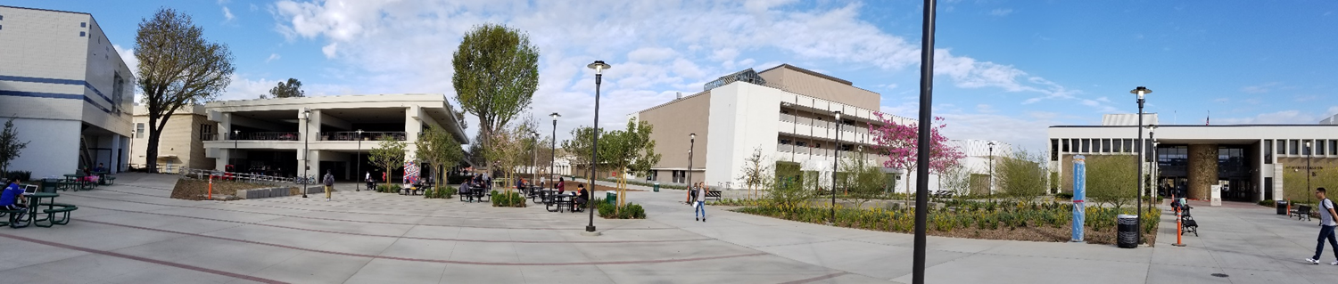
Workshop Overview
Meet your CAP Success Team
Guided Pathways
What is your Career & Academic Pathway?
Community Conversations
Q&A
Notes:
Give students an overview about this workshop. Encourage students to participate in workshops throughout the day.

Slide 5
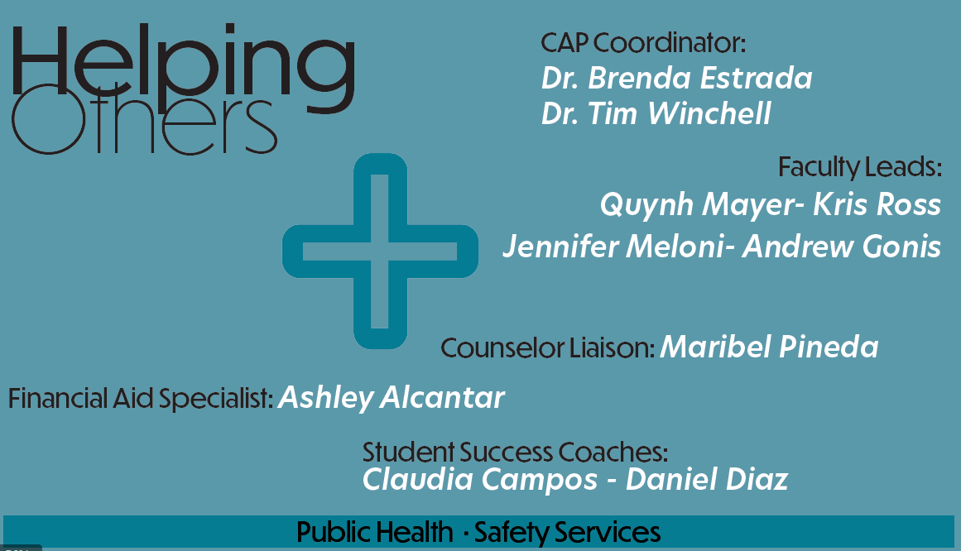
Success Team Introduction

Slide 6








SAC Practices
Guided Pathways!
Restructuring to increase student success
Provides clear pathways
Integrates support services

Slide 7


Career & Academic Pathways (CAP)
Notes:
Career and Academic Pathways are a collection of majors with related courses that fit within a career area. Help guide students to the flyer that contains the majors within each CAP.

Slide 8

Career & Academic Pathway
You are a member of this CAP!
A CAP is a community of learners in related fields of study.
Helping Others: Public Health & Safety Services

Slide 9
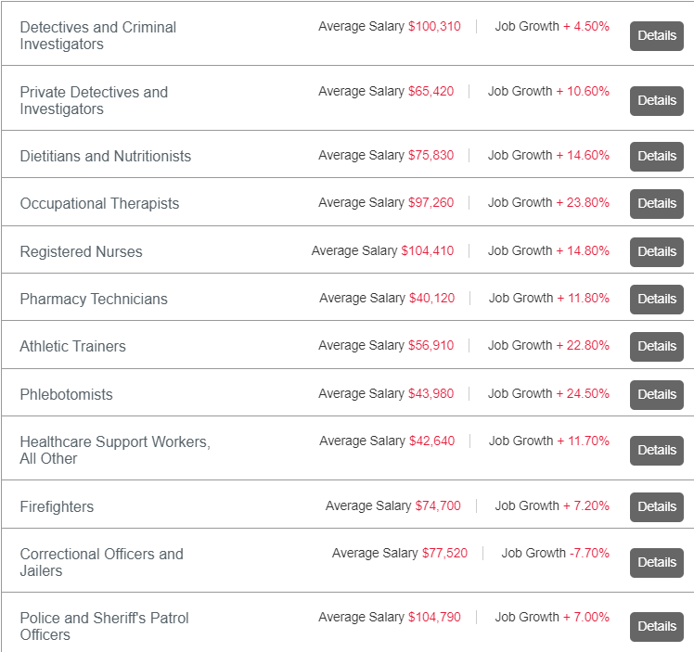


What can I do with my Major?
https://www.sac.edu/Pathways/Public_Health_Safety_Services/Pages/default.aspx
Notes:
Ask students to reflect & share: Do you see any careers on this list that you may be interested in? If not, what other careers do you want to explore?

Slide 10
What’s Unique about our CAP
ADD INFO: What would I experience in the program?
Exciting news, programming or events in this CAP

Slide 11
Connection, Community and Communication
What about college are you most excited about?
What are your concerns/challenges? We’d like to support you.
Questions?
Notes:
Discuss the role of college in supporting self-exploration (interest, values, careers) with students
Ask students to reflect & share: What interests do you have? What strengths do you bring?
It’s okay if you’re not sure - but important to start asking these questions as you enter and continue on your educational journey/process
Facilitator note: We won’t ask students to answer all of the questions on the slide. Instead, highlight that all of these questions are areas that the CAPs are there to help you explore during your time at SAC.

Slide 12
Canvas Shells
A virtual space to ask questions.
Directly contact your Success Team via Pronto.
CAP events and hours will be hosted through the ConferZoom page.
Receive messages directly related to your CAP.

Slide 13
Career Planning
Career Center
Employment Preparation Workshops
Career Education Counseling
Let's Decide! (Undecided Major Workshops & Counseling)
Career Research & Exploration Software
Online Job Board
On Campus Recruitment/Interviews
Career Classes
CNSL 116: Career and Life Planning
CNSL 100: Lifelong Understanding and Self Development
CNSL 114: Careers in Teaching
https://www.sac.edu/StudentServices/Counseling/CareerCenter/Pages/default.aspx
Notes:
Describe the services that the Career Center provides to SAC students. Encourage students to attend a workshop or take one of the following courses:
CNSL 116 – Career and Life Planning
CNSL 100 – Lifelong Understanding and Self Development
CNSL 114 – Careers in Teaching

Slide 14

Is this the right CAP for me?
If you’re unsure about your CAP
Attend a Career Inventory Workshop (SuperStrong)
  Assessment Center
  sac.edu/assessment
Schedule an appointment with the Career Center
Career Center
sac.edu/careercenter
Notes:
Ask students to reflect & respond: How does this feel so far?
Yup, in the right place
I'm not sure - still figuring it out
Definitely not in the right place
Via zoom poll
Facilitator note: Even if you’re unsure or feel this isn’t the right CAP for you, the information you get from this session is still relevant - learn what you can expect from any CAP & where to go if you have questions
Communicate to students that they still have time to explore other Career Pathways if undecided. Encourage them to make an appointment with a counselor to explore their options. (more info on next slide)

Slide 15
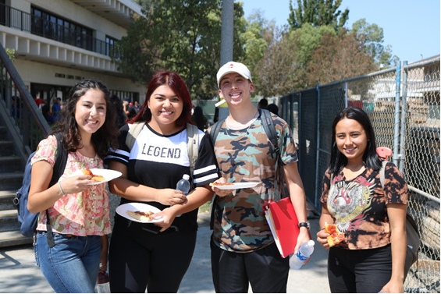
Student Life
Clubs
Activities
Leadership
Workshops
How will you get the most out of your college experience?
https://www.sac.edu/StudentServices/StudentLife/Pages/default.aspx
Notes:
Why join clubs and activities on campus?
support exploration and self-discovery (identify interests, build skills)
clubs can help you find a community & a place of belonging (plus, getting involved can help bring a sense of pride & school spirit)
Ask students (without requirement to share): Are there any clubs that you may be interested in joining?

Slide 16








Building Bridges – sac.edu/sce
Success Team Question: What do we want students to take away from building bridges?
Notes:
SAC School of Continuing Education representatives will briefly introduce themselves and share information about their programs.

Slide 17
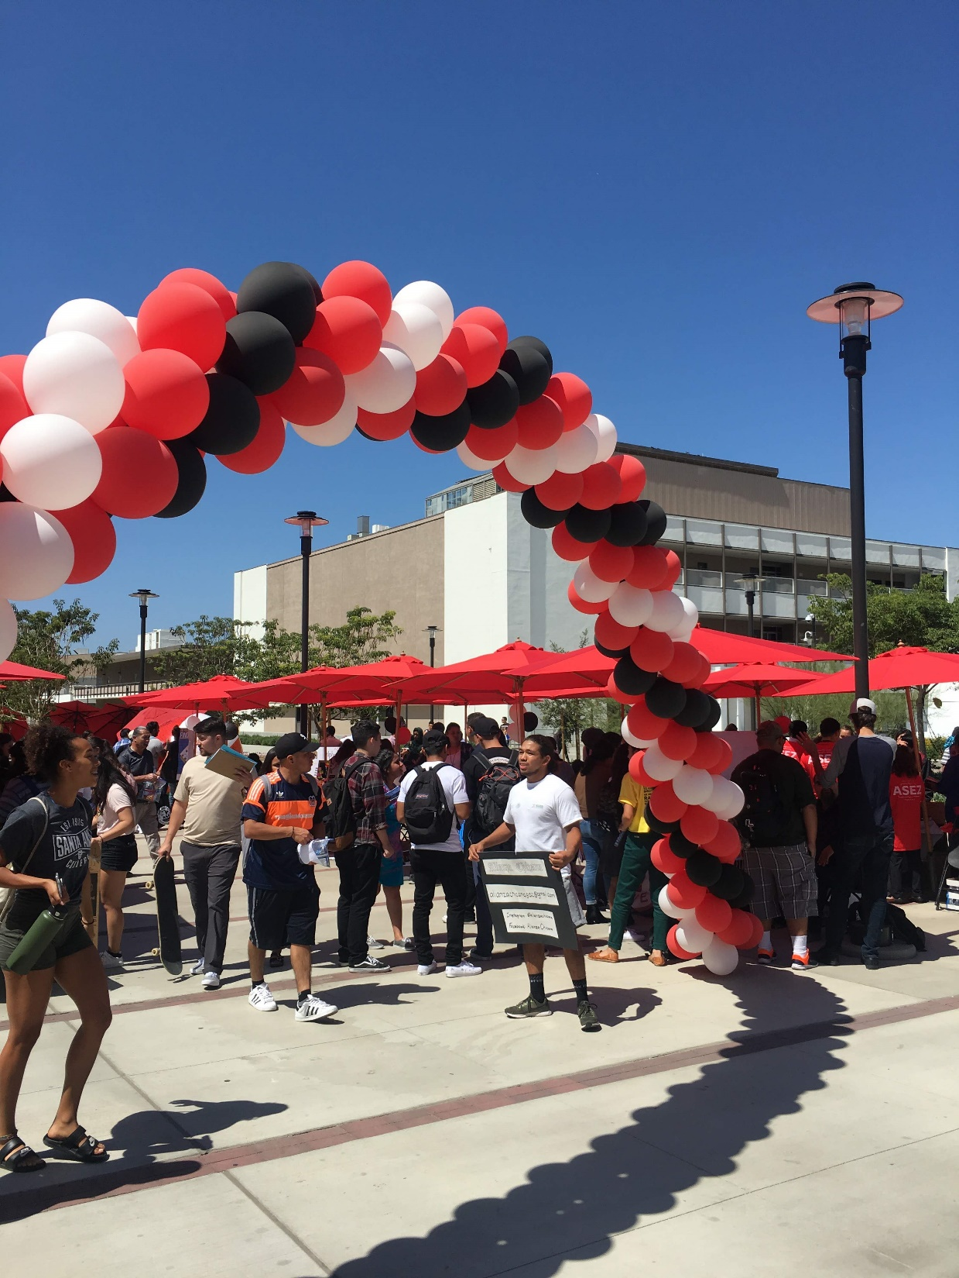
Closing Reflection
Reflection
What comes to mind now when you think about college?
What are some things you heard from today that could help you be successful in college?

Slide 18


Questions?

Slide 19
What is next?
Career and Academic Pathway Exploration Months
Learn more about majors and careers related to your area of interest
September: Creating Our World
October: People, Ideas, & Culture
November: Future Educators
February: Money Matters
March: Design, Make & Move
April: STEM
May: Helping Others
Additional Support Services
Counseling – Click here
Career Center - Click here
Transfer Center – Click here
Library – Click here
Health & Wellness – Click here
Disability Resource Center – Click here
Notes:
Let students know that there would be CAP Careers Exploration months throughout the semester.
Please encourage students to attend the CAP
Career Exploration events hosted by the Career Center.

Slide 20
Post in the Chat How We Can best Contact You.

Slide 21

For Further Questions
General Questions: sac.edu
Financial Aid: sac.edu/financialaid
Counseling: sac.edu/counseling
Guided Pathways: sac.edu/pathways
This session was co-designed with the Career Ladders Project.

